Slide 1
Review of Multivariate Calculus and Optimization by Gradient Descent
CMPUT 328
Nilanjan Ray
Computing Science, University of Alberta, Canada

Slide 2
Review of partial derivatives
Need to review
Functions of several variables and vector valued functions
Partial derivatives and gradient
Hessian and Jacobian
https://en.wikipedia.org/wiki/Partial_derivative
Also look at basics of multi-variate calculus https://www.khanacademy.org/math/multivariable-calculus

Slide 3
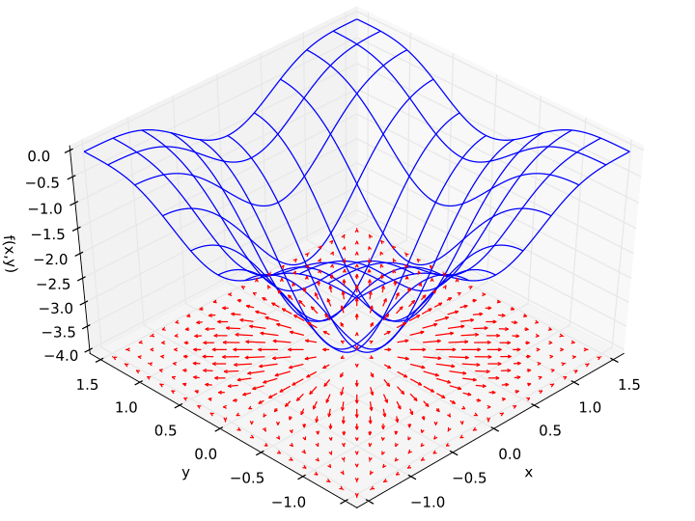

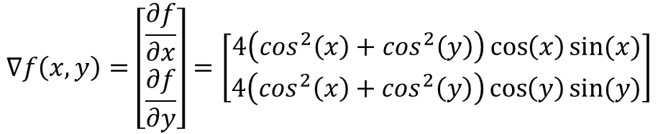
Gradient of a function
Example:
$$f\left(x,y\right)=−{\left(\cos^{2}x+\cos^{2}y\right)}^{2}$$
$$∇f\left(x,y\right)=\left[\begin{matrix}\frac{∂f}{∂x} \\ \frac{∂f}{∂y}\end{matrix}\right]=\left[\begin{matrix}4\left(\cos^{2}\left(x\right)+\cos^{2}\left(y\right)\right)\cos\left(x\right)sin⁡(x) \\ 4\left(\cos^{2}\left(x\right)+\cos^{2}\left(y\right)\right)\cos\left(y\right)sin⁡(y)\end{matrix}\right]$$
Note 1: f is a function of two variables,
so gradient of f is a two dimensional vector
Note 2: Gradient (vector) of f points toward the
steepest ascent for f
Note 3: At a (local) minimum of f its gradient
becomes a zero vector
Example source: Wikipedia

Slide 4
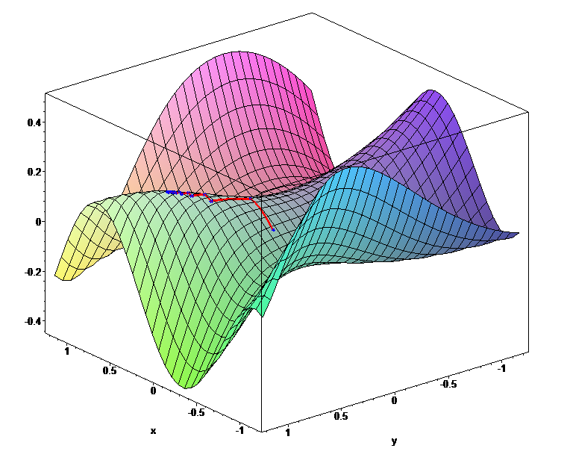
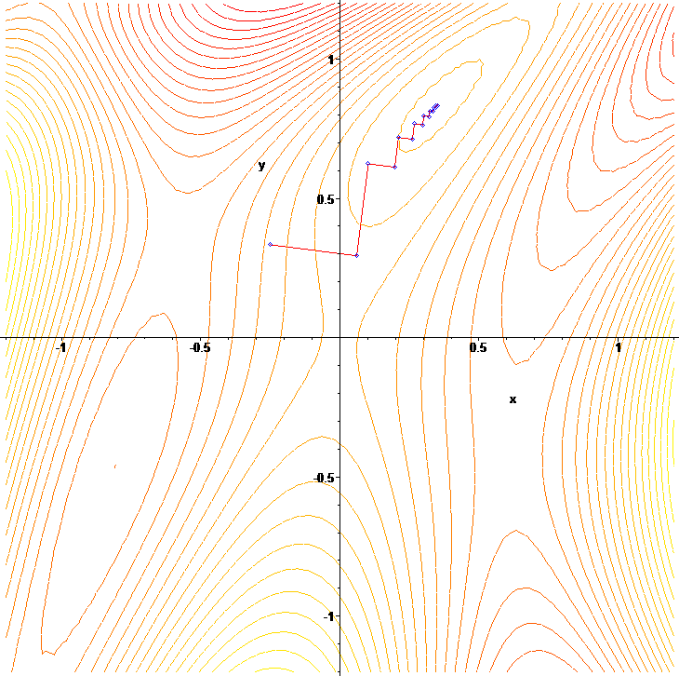



Gradient descent optimization
Start at an initial guess for the optimization variable:
$$x_{0}$$
Gradient descent algorithm
Iterate until gradient magnitude becomes too small:
$$x^{t+1}=x^{t}−α∇f(x^{t})$$
$$α$$
is called the step-length.
f(x, y)
Gradient descent creates
a zig-zag path leading to
a local minimum of f
Picture source: Wikipedia

Slide 5

Example partial derivative computations
Let’s consider the following function:
Let’s compute derivative of this function at
Cross-verify PyTorch partial derivative computations with math formulas
Gradient descent optimization
$$f\left(x_{1},x_{2},x_{3},x_{4}\right)={(x_{1}+10x_{2})}^{2}+5{(x_{3}−x_{4})}^{2}+{(x_{2}+2x_{3})}^{4}+10{(x_{1}−x_{4})}^{4}$$
$$\left[x_{1},x_{2},x_{3},x_{4}\right]=\left[3,−1,0,1\right]$$
Partial_Derivatives_and_GD_and_chain_rule.ipynb

Slide 6

Chain rule of derivatives
Let consider the same function as before:
But, this time x is a vector-valued function of variable z:
Let’s compute gradient of f with respect to z using chain rule: Jacobian vector product
$$f\left(x_{1},x_{2},x_{3},x_{4}\right)={(x_{1}+10x_{2})}^{2}+5{(x_{3}−x_{4})}^{2}+{(x_{2}+2x_{3})}^{4}+10{(x_{1}−x_{4})}^{4}$$
$$x_{1}=z_{1}−z_{2},$$
$$x_{2}=z_{1}^{2},$$
$$x_{3}=z_{2}^{2},$$
$$x_{4}=z_{1}^{2}+z_{1}z_{2}$$
Partial_Derivatives_and_GD_and_chain_rule.ipynb

